Slide 1
Security
Distributed Computer Systems
CT024-3-3-DCOMS and Version VC1

Slide 2
Topic & Structure of The Lesson
Define Security in DS
Secure Communication
Discuss about the Authentication
Type of threats
Security mechanism
Cryptography
Digital Signature

Slide 3
Learning Outcomes
At the end of this topic, You should be able to
Understand about Secure communication
Explain about the authentication
Understand about the cryptography
Discuss about the digital signature

Slide 4
Key Terms You Must Be Able To Use
If you have mastered this topic, you should be able to use the following terms correctly in your assignments and exams:
Security
Communication
Authorization
Threat
Mechanism
Digital Signature

Slide 5
Security
Strategies for securing Distributed Systems
Generally very similar to techniques used in a non-distributed system, only much more difficult to implement …
Difficult to get right, impossible to get perfect!

Slide 6
Security Topics
Providing a secure communications channel – authentication, confidentiality and integrity.
Handling authorization – who is entitled to use what in the system?
Providing effective Security Management.
Example systems: SESAME and e-payment systems.

Slide 7
Type of Threats
Interception – unauthorized access to data.
Interruption – a service becomes unavailable.
Modification – unauthorized changes to, and tampering of, data.
Fabrication – non-normal, additional activity.

Slide 8
Security Mechanisms
Encryption – fundamental technique: used to implement confidentiality and integrity.
Authentication – verifying identities.
Authorization – verifying allowable operations.
Auditing – who did what to what and when/how did they do it?

Slide 9
Key Point
Matching security mechanisms to threats is only possible when a Policy on security and security issues exists.

Slide 10
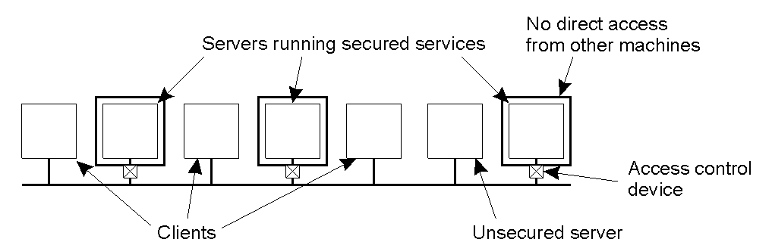
Distribution of Security Mechanism
The Trusted Computing Base (TCB) is the set of services/mechanisms within a distributed system required to support a security policy.

Slide 11
Security Mechanism
Fundamental technique within any distributed systems security environment:
Cryptography

Slide 12
Types of Cryptosystems
Symmetric: often referred to as conventional cryptography, defined as:
P = D_{k} ( E_{k} ( P ) )
Asymmetric: often referred to as public-key cryptography, defined as:
P = D_{kd} ( E_{ke} ( P ) )

Slide 13
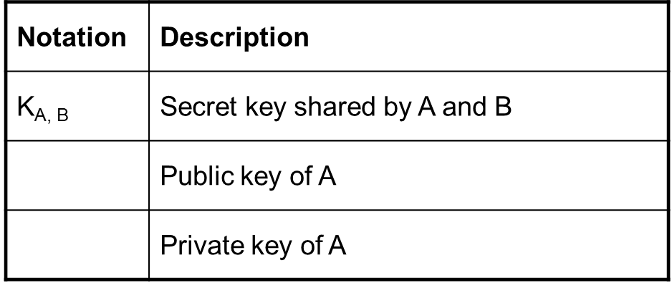
Notation of Cryptography

Slide 14
Applications of Cryptography
Authentication.
Message Integrity.
Confidentiality.

Slide 15
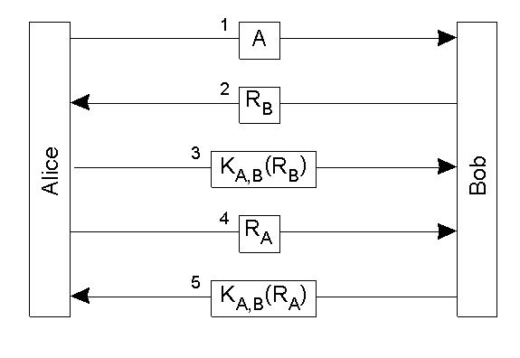
Authentication
Authentication based on a shared secret key, using a ‘challenge response’ protocol. Note: R is a random number.

Slide 16
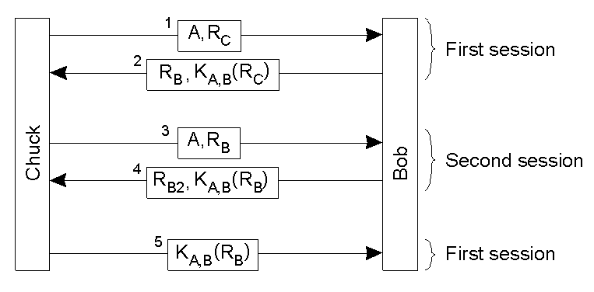
An Authentication Attack
The ‘reflection attack’. Chuck wants Bob to think he is Alice, so he starts up a second session to trick Bob.

Slide 17

Authentication Using Public-Key Cryptography
Mutual authentication in a public-key cryptosystem.
Note that the KDC is missing … but, this assumes that some mechanism exists to verify everyone’s public key.

Slide 18
More on Secure Channels
In addition to authentication, a secure channel also requires that messages are confidential, and that they maintain their integrity.
For example: Alice needs to be sure that Bob cannot change a received message and claim it came from her. And Bob needs to be sure that he can prove the message was sent by/from Alice, just in case she decides to deny ever having sent it in the first place.
Solution: Digital Signing.

Slide 19
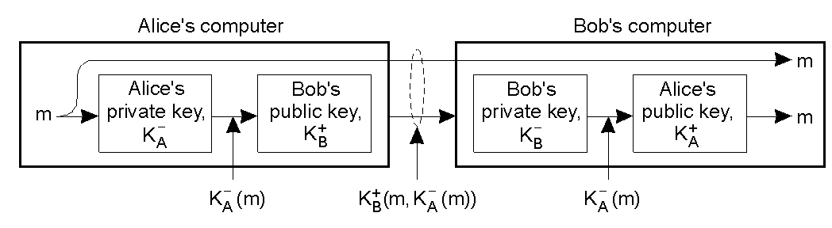
Digital Signatures
Digital signing a message using public-key cryptography.
This is implemented in the RSA technology.
Note: the entire document is encrypted/signed - this can sometimes be a costly overkill.

Slide 20
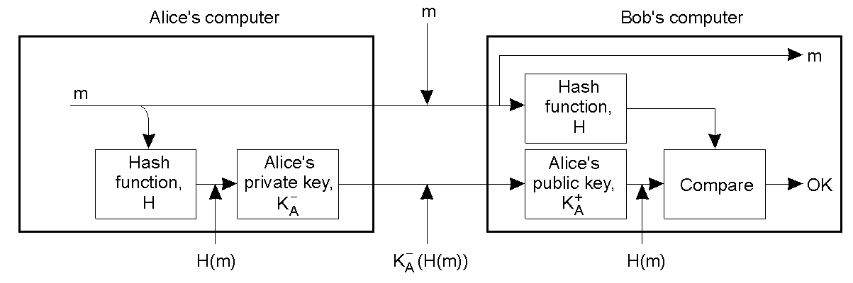
Digital Signature Digests
Digitally signing a message using a message digest.
Message is sent as plaintext. However, the digest can be used to assure Bob of message integrity.

Slide 21
Access Control
Authorization is the process of
“granting access rights” to a user/process.
Access Control is the process of
“verifying access rights” for an authorized user/process.

Slide 22
Needham-Schroeder Protocol
This original work includes secret-key protocol and public key protocol
Public-key protocol does not depend on the existence of authentication server and is hence more suitable for use in networks with many independent management domains.
Secret-key protocol provides a solution to authentication and key distribution based on an authentication server

Slide 23
Needham-Schroeder Secret-key Protocol
The protocol is based on the generation and transmission of ticket by the authentication server.
A ticket is an encrypted message containing a secret key for use in communication between A and B

Slide 24
Summary
Providing a secure communications channel – authentication, confidentiality and integrity.
In addition to authentication, a secure channel also requires that messages are confidential, and that they maintain their integrity by using digital signature
Access Control is the process of
“verifying access rights” for an authorized user/process.

Slide 25
Question and answer session
Q & A

Slide 26
What we will cover next
Name Services

